Slide 1
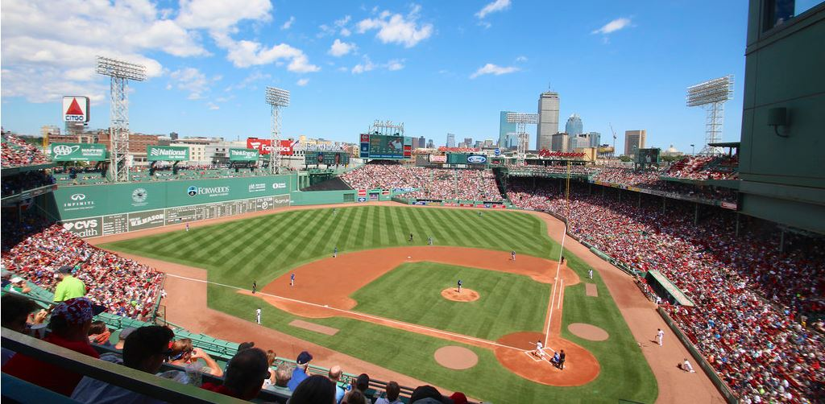
Sounds of a Baseball Game

Slide 2
The crack of a bat

Slide 3
The pitch hitting the catcher’s glove

Slide 4
Singing

Slide 5
The crowd cheering

Slide 6
The umpire

Slide 7
Food Vendors

