Slide 1
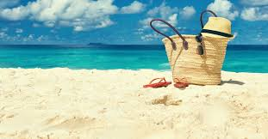
Sounds of the Beach

Slide 2
A Boat

Slide 3
Splashing in the Water

Slide 4
A Lifeguard Whistle

Slide 5
The Sizzling of a Grill

Slide 6
Waves Crashing

Slide 7
Music Playing

Slide 8
Kids playing

Slide 9
A dolphin

Slide 10
Ice Cream Truck

Slide 11
Footsteps in the Sand

Slide 12
Soda being opened

